Slide 1
Programming paradigms
Shahnaz Mammadova

Slide 2
What is programming paradigm?
How do programmers deal with complexity? There are many general approaches that reduce complexity in a program or make it more manageable. One of the main approaches is a programming paradigm.
The term programming paradigm refers to a style of programming. It does not refer to a specific language, but rather it refers to the way you program.
There are lots of programming languages that are well-known but all of them need to follow some strategy when they are implemented. And that strategy is a paradigm.

Slide 3

Let's look at programming paradigms

Slide 4
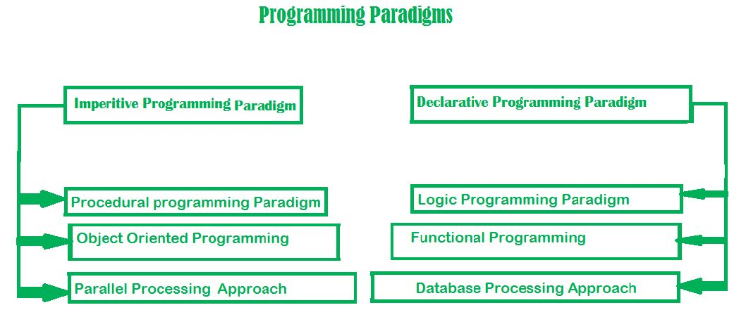

Slide 5
Imperative programming paradigm
The paradigm consists of several statements, and after the execution of all of them, the result is stored. It’s about writing a list of instructions to tell the computer what to do step by step.
In an imperative programming paradigm, the order of the steps is crucial, because a given step will have different consequences depending on the current values of variables when the step is executed.

Slide 6
Procedural programming paradigm
Procedural programming (which is also imperative) allows splitting those instructions into procedures.
NOTE: Procedures aren’t functions. The difference between them is that functions return a value, and procedures do not. More specifically, functions are designed to have minimal side effects, and always produce the same output when given the same input. Procedures, on the other hand, do not have any return value. Their primary purpose is to accomplish a given task and cause a desired side effect.
A great example of procedures would be the well known for loop. The for loop’s main purpose is to cause side effects and it does not return a value.

Slide 7
Object-oriented programming paradigm
The key characteristics of object-oriented programming include Class, Abstraction, Encapsulation, Inheritance and Polymorphism.
Abstraction separates the interface from implementation.
Encapsulation is the process of hiding the internal implementation of an object.
Inheritance enables hierarchical relationships to be represented and refined.
Polymorphism allows objects of different types to receive the same message and respond in different ways.

Slide 8
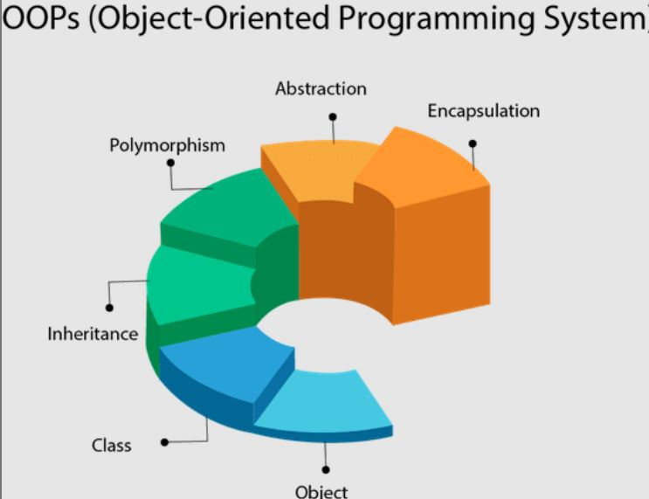
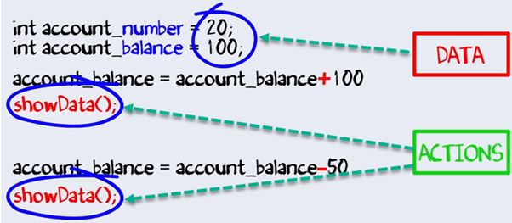
OOP

Slide 9
Parallel processing approach
Parallel processing is the processing of program instructions by dividing them among multiple processors.
A parallel processing system allows many processors to run a program in less time by dividing them up.

Slide 10
Declarative programming paradigm
Declarative programming is a style of building programs that expresses the logic of a computation without talking about its control flow.
The main differences are that imperative tells you how to do something and declarative tells you what to do.

Slide 11
Logic programming paradigm
The logic programming paradigm takes a declarative approach to problem-solving. It’s based on formal logic.
The logic programming paradigm isn’t made up of instructions — rather it’s made up of facts and clauses.
It uses everything it knows and tries to come up with
the world where all of those facts and clauses are true.

Slide 12
Functional programming paradigm
The functional programming paradigm has its roots in mathematics and it is language independent. The key principle of this paradigm is the execution of a series of mathematical functions.
You compose your program of short functions. All code is within a function. All variables are scoped to the function.
In the functional programming paradigm, the functions do not
modify any values outside the scope of that function and
the functions themselves are not affected by any values outside their scope.

Slide 13
Database processing approach
This programming methodology is based on data and its movement. Program statements are defined by data rather than hard-coding a series of steps.

Slide 14
Thanks for your attention!

